Slide 1
PointNET AE
By Elvis Kimara

Slide 2

Was able to make a PointNET AE
Uses 2 convolutional layers
Added code to control the latent size of the last layer
Tested results of different latent vector sizes

Slide 3
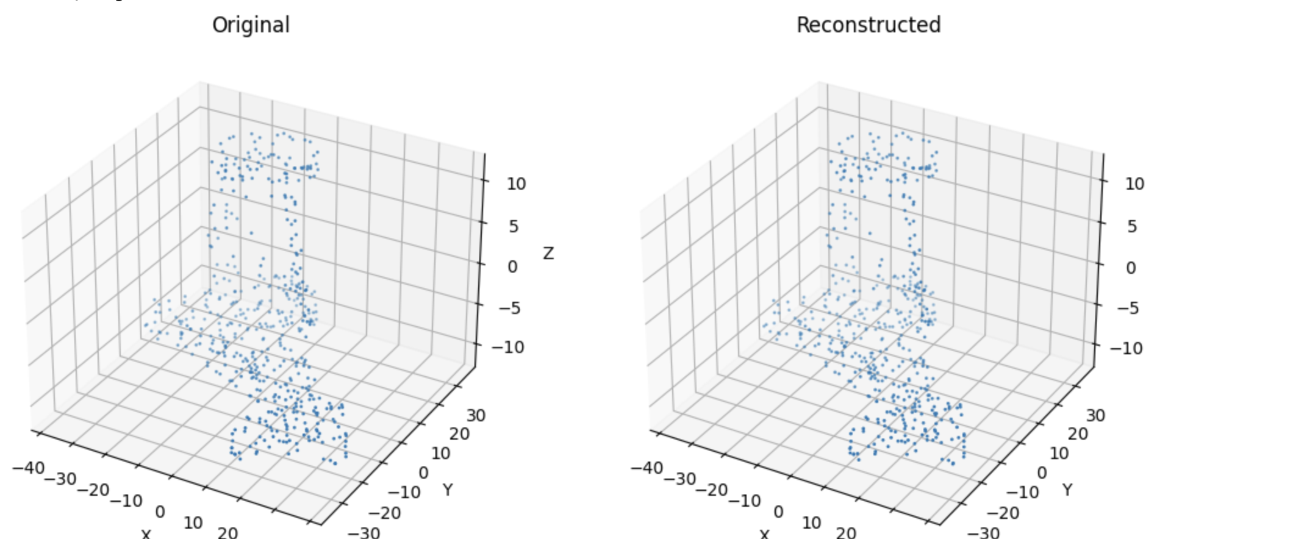
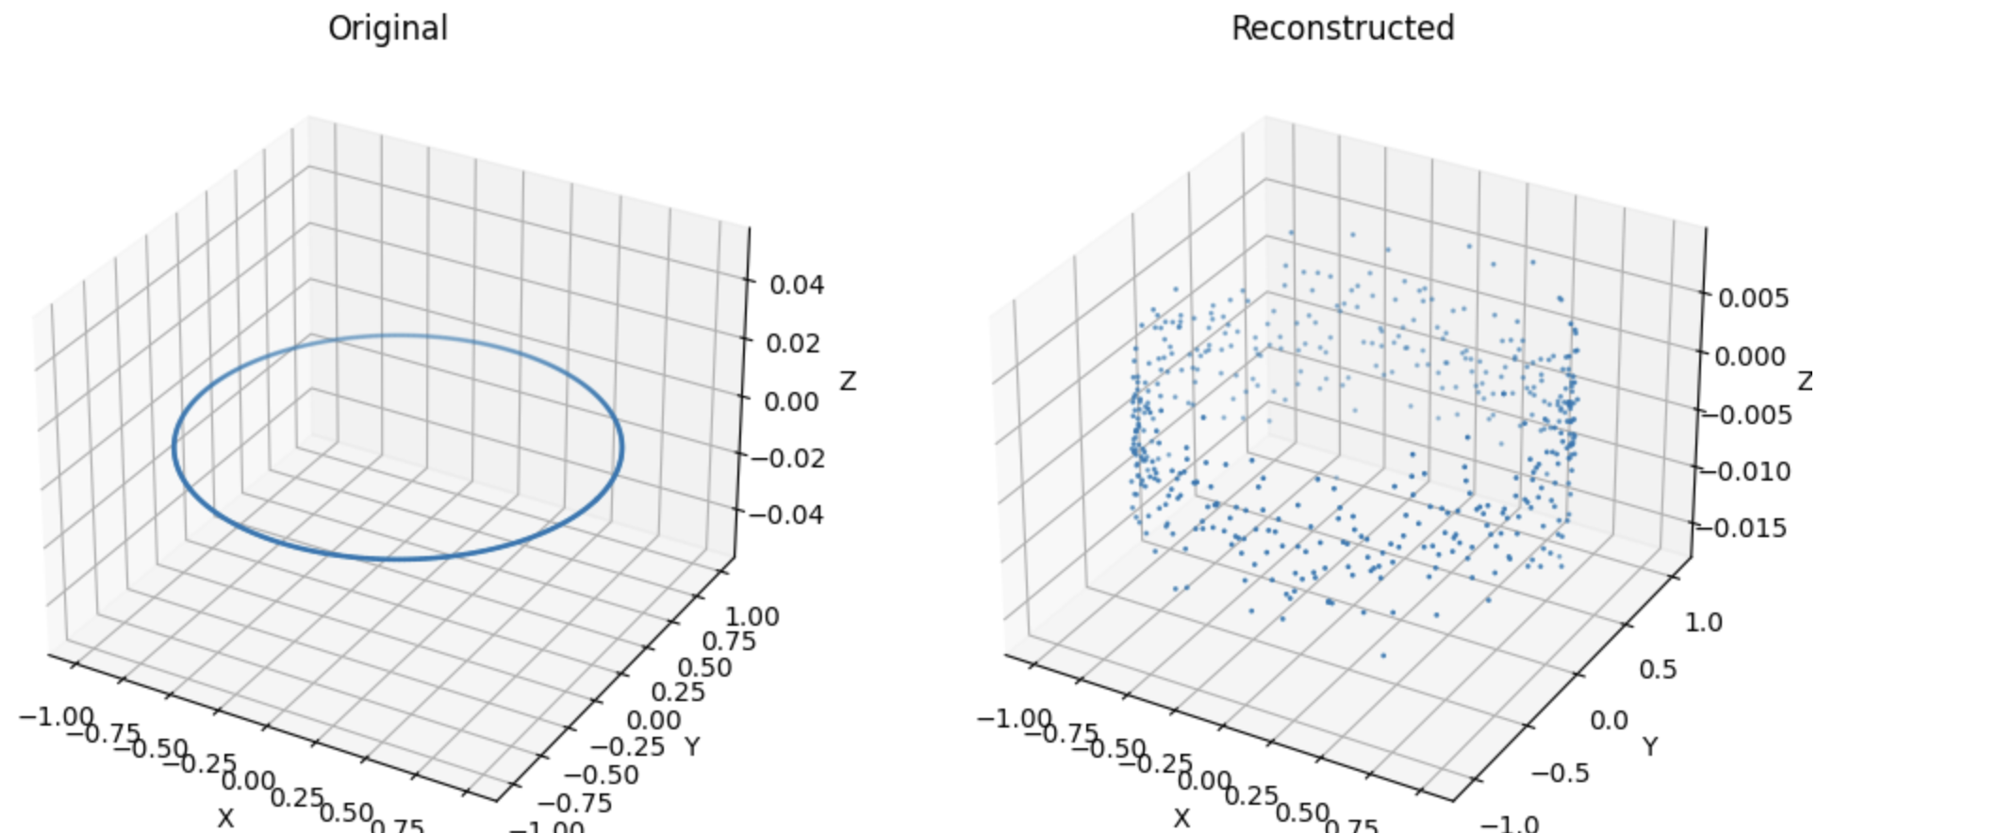
Was able to Train model on multiple point clouds

Slide 4
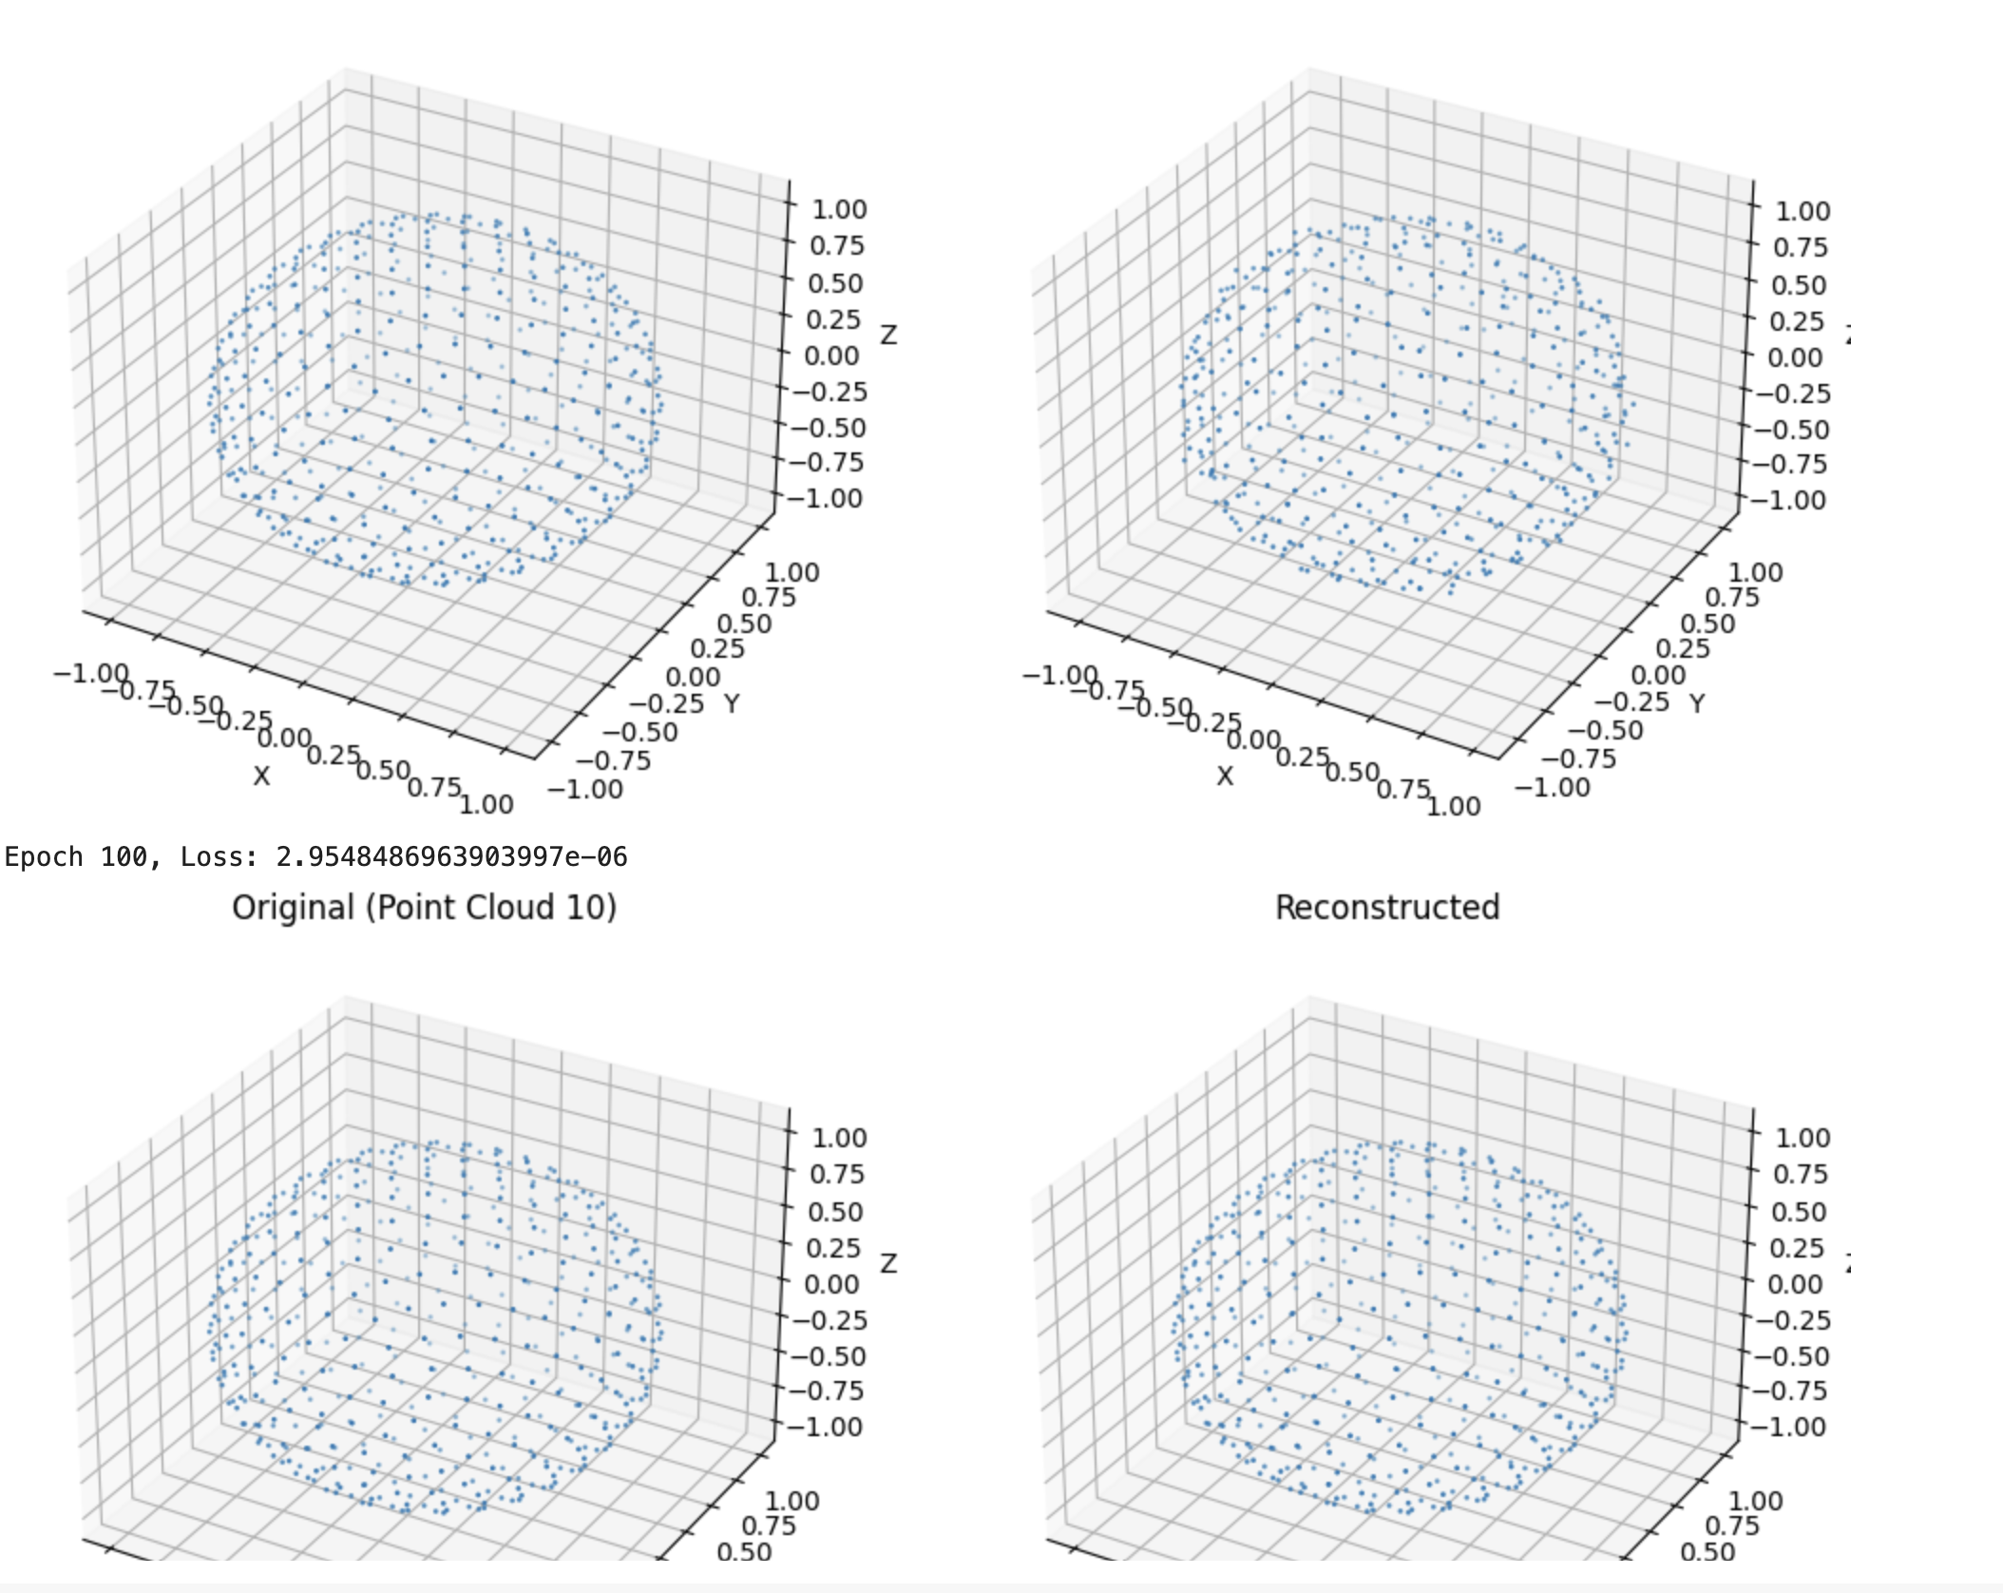
Was able to Train model on single point cloud

Slide 5
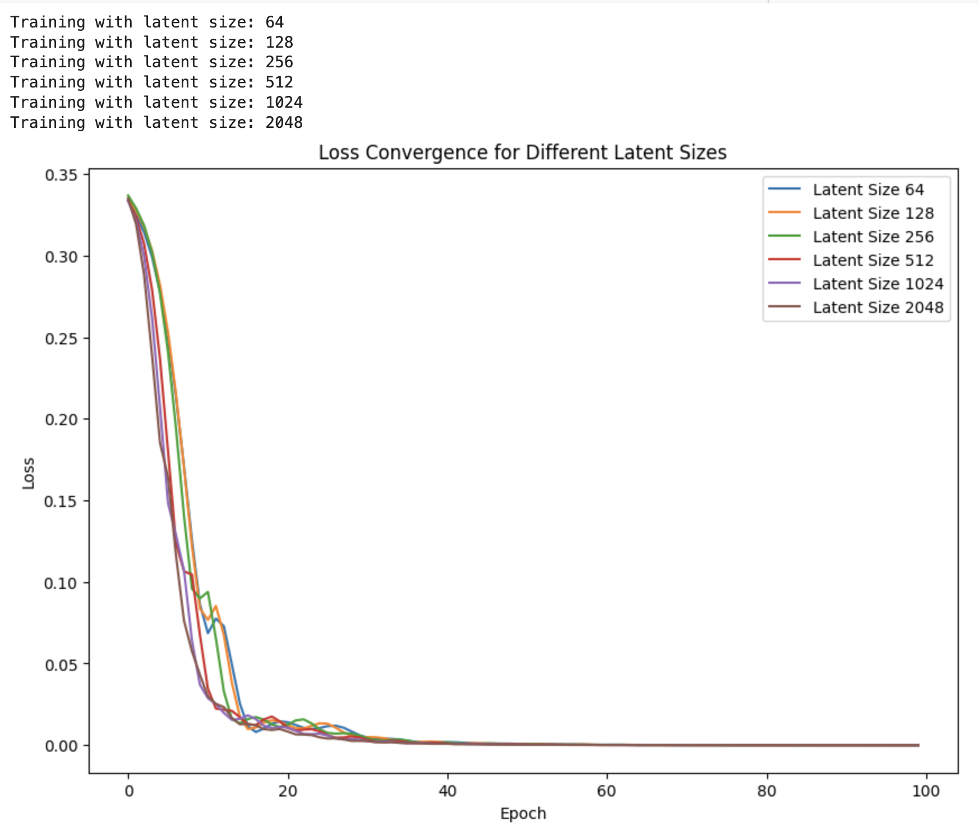
Compared Training with different lantent vector sizes

Slide 6
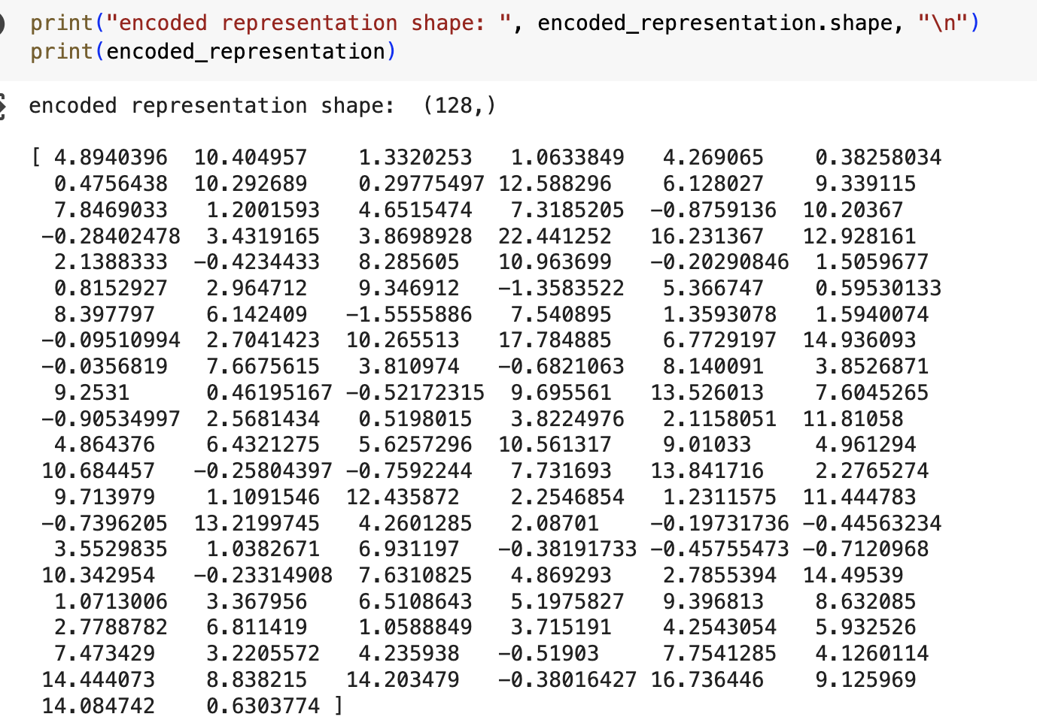
Added ability to do inference on any point cloud and get a vector representation of set shape

Slide 7
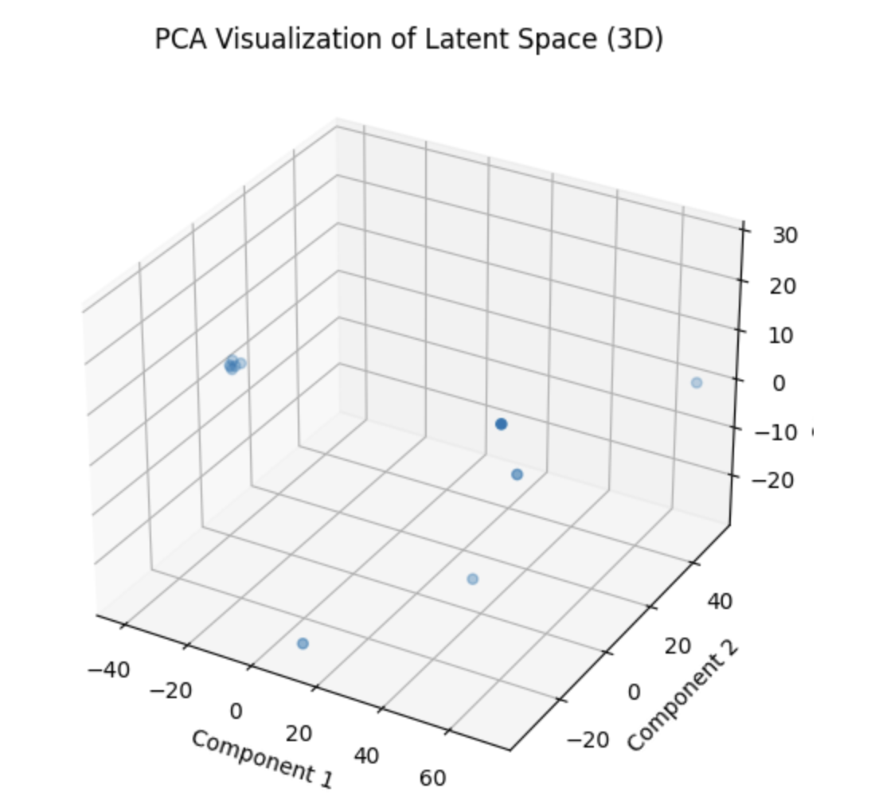
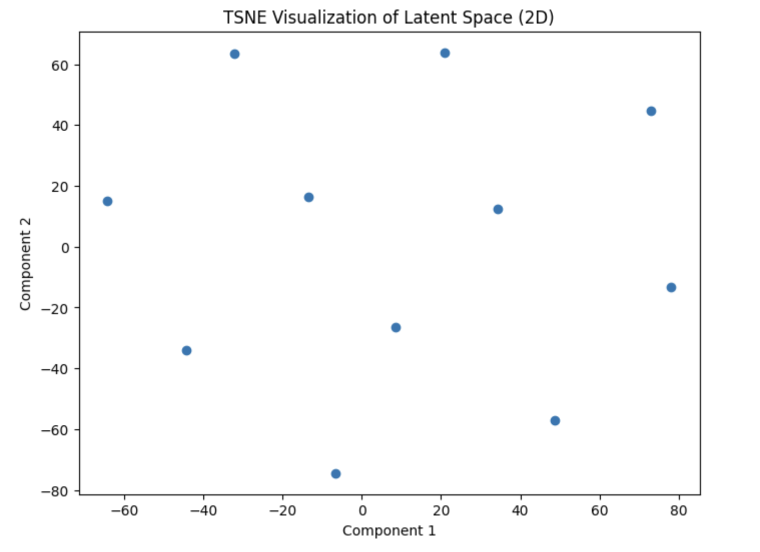
Currently experimenting with PCA and TSNE for latent visualization

Slide 8
Questions

